Slide 1


VOICE-TO-TEXT-BASED MUSIC RECOMMENDATION USING LSTM MODEL Guide: P. RADHAKRISHNAN
BATCH – 45
TEAM MEMBERS
2003A51173 MULUKUNTLA NAVYA SRI
2003A51037 JANGA SRI CHANDANA
2103A51L10 GADDAM SHIVA KUMAR
2003A51218 CHINTHIREDDY SANATH REDDY
2003A51223 MOOLA KARTHIK

Slide 2





CONTENTS
Problem Identification
Literature Review
Defining Objective of the Problem
Proposed Plan
Conclusion

Slide 3
1. PROBLEM IDENTIFICATION
One of the key challenges in developing a Voice-to-Text Based Music Recommendation System using machine learning lies in accurately predicting the user's mood or emotional state from spoken input.
While machine learning models such as LSTM networks show promise in analyzing textual data and capturing temporal dependencies, accurately inferring complex emotional cues from speech remains a nuanced task.
Additionally, ensuring the robustness and generalizability of the model across diverse user demographics and linguistic variations poses a significant challenge.
Addressing these issues requires thorough data collection, feature engineering, and model refinement to improve the system's accuracy, reliability, and user satisfaction.

Slide 4

2. LITERATURE REVIEW

Slide 5
S.NO | TITLE | YEAR | AUTHOR | ALGORITHM USED | ADVANTAGES | DIS-ADVANTAGES
1 | Survey of Music Recommendation Systems | 2011 | Xavier Serra and Jordi Janer | Collaborative filtering, | Provides an overview of various recommendation methods, including collaborative filtering and content-based approaches. | Cold-start problem for new users or items, limited coverage for niche preferences.
2 | Deep Learning Techniques for Music Generation - A Survey | 2019 | Li-Chia Yang, Szu-Yu Chou, and Yi-Hsuan Yang | Deep learning models | Surveys the application of deep learning techniques such as RNNs, CNNs, and GANs in music generation tasks. | Challenges with data scarcity, model interpretability, and integrating user preferences.
3 | Music Emotion Recognition: A State-of-the-Art Review | 2011 | Yi-Hsuan Yang, Homer H. Chen, and Yeh-Shen Chen | Various machine learning | Reviews techniques and methodologies for automatically analyzing and categorizing the emotional content of music. | Subjective nature of emotional perception, lack of standardized evaluation datasets.
4 | Voice User Interface (VUI) Design | 2004 | James Giangola, Jennifer Balogh, and Michael H. Cohen | Voice user interface (VUI) | Offers comprehensive guidance on designing effective voice user interfaces, covering principles, methodologies, and best practices. | Usability challenges with speech recognition accuracy, limitations in handling complex interactions.

Slide 6

3. DEFINING OBJECTIVE OF THE PROBLEM
Develop a Voice-to-Text Based Music Recommendation System using machine learning techniques to accurately predict the user's mood or emotional state from spoken input.
Integrate the recommendation system with a Long Short-Term Memory (LSTM) model to leverage its ability to capture temporal dependencies and contextual information for personalized and context-aware music recommendations.

Slide 7

4. PROPOSED PLAN
Develop and implement a prototype of the Voice-to-Text Based Music Recommendation System, integrating voice recognition, LSTM modeling, and audio playback functionalities, followed by thorough testing and evaluation to assess the accuracy, usability, and effectiveness of the system in providing personalized music recommendations based on user mood.

Slide 8
INPUT DATA
Spoken Input Data: This includes audio recordings of users' spoken input, which will be converted to text using speech recognition algorithms. You can collect these recordings through microphone input or through pre-recorded audio files.
Textual Data: Once the spoken input is converted to text, you'll use this text data as input to your machine learning model for mood prediction. This data can include transcripts of user commands or queries related to music preferences, emotions, or mood.

Slide 9
Music Metadata: Information about the songs in your database, such as title, artist, genre, and mood. This metadata will be used to recommend appropriate songs based on the predicted mood.
Training Data: If you're training a machine learning model (such as an LSTM) for mood prediction, you'll need a labeled dataset containing text samples along with their corresponding mood labels. You can collect this data from various sources, including user feedback, music annotations, or existing mood-labeled datasets.
Validation Data: A separate portion of labeled data used to validate the performance of your machine learning model during training and fine-tuning.

Slide 10
TOOLS & TECHNOLOGIES USED
Tools Used:
Python: Programming language for development and implementation.
TensorFlow / Keras: Deep learning frameworks for building and training machine learning models, including LSTM networks.
Pandas / NumPy: Python libraries for data manipulation and numerical operations.
Speech Recognition: Python library for converting spoken input to text using speech recognition algorithms.
Pyttsx3: Python library for text-to-speech conversion, used for providing audio feedback to users.
Pygame: Library for audio playback, enabling the system to play recommended songs.
Tkinter: Python library for creating graphical user interfaces (GUIs), used for designing the user interface of the recommendation system.

Slide 11
Techniques Used:
Voice Recognition: Technique for converting spoken input into text, facilitating user interaction with the system.
Long Short-Term Memory (LSTM): Recurrent neural network architecture used for analyzing textual data and predicting user mood based on spoken input.
Machine Learning: Techniques for training and fine-tuning the LSTM model using labeled datasets for mood prediction.
Natural Language Processing (NLP): Techniques for preprocessing text data, including tokenization and sequence padding, to prepare it for input to the LSTM model.
Audio Processing: Techniques for handling audio files and extracting features for music recommendation, such as song metadata and mood labels.
User Interface Design: Techniques for designing an intuitive and user-friendly interface using Tkinter for seamless interaction with the recommendation system.
Testing and Evaluation: Techniques for assessing the accuracy, usability, and effectiveness of the recommendation system through thorough testing and evaluation procedures.

Slide 12
IMPLEMENTATION
1. Data Collection
3. Model Development
4. Integration with Recommendation System
2. Preprocessing

Slide 13
5. User Interface Design
7. Testing and Evaluation
6. Audio Playback
8. Deployment

Slide 14
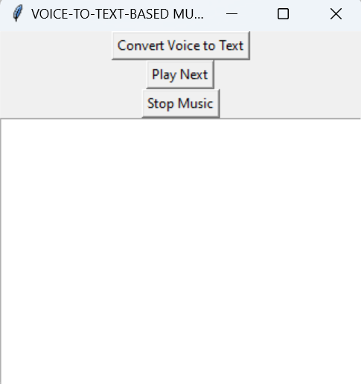
RESULTS

Slide 15
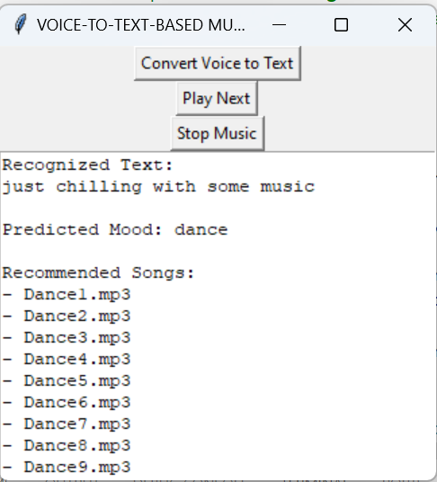

Slide 16

5. CONCLUSION
The successful implementation of the Voice-to-Text Based Music Recommendation System demonstrates its potential to revolutionize music discovery and consumption by leveraging machine learning and natural language processing techniques to provide personalized recommendations based on user mood.

